Slide 1
PIP2001 Capstone Project
Review-FINAL
ONLINE CHATBOT BASED TICKETING SYSTEM
Batch Number: PSCS_353
Roll Number | Student Name
20211CSE0738 | PALLE HARSHA VARDHAN REDDY
20211CSE0754 | CHANDRA SEKHAR REDDY UDUMULA
20211CSE0702 20211cse0701 | YAMBA MAHESH BUGGA MOHAN
Under the Supervision of,
Dr. JOSEPH MICHAEL JERARD
Assistant Professor -Senior Scale
School of Computer Science and Engineering
Presidency University
Name of the Program: CSE
Name of the HoD: Dr.Asif Mohammed H.B
Name of the Program Project Coordinator: Dr. JOSEPH MICHAEL JERARD
Name of the School Project Coordinators: Dr. ABDUL KHADAR A

Slide 2
Abstract
Visitors to museums, theaters, and public attractions often experience long waiting times and inefficiencies due to manual ticket booking systems. These systems are prone to errors such as incorrect ticket issuance, double bookings, and data loss. To enhance visitor experience and streamline operations, this project proposes an online chatbot-based ticketing system. The chatbot will offer automated, real-time booking, multilingual support, and integrated payment gateways, reducing human intervention and minimizing errors. This system aims to improve customer service, enhance accessibility, and provide valuable data analytics for optimizing ticketing operations.

Slide 3
Literature Survey
https://link.springer.com/article/10.1007/s42979-023-02457-x
https://papers.ssrn.com/sol3/papers.cfm?abstract_id=4264945
https://www.researchgate.net/publication/358795459_Analysis_of_Personal_Data_Visualization_Reviews_On_mHealth_Apps_short_paper
https://www.researchgate.net/publication/372971016_Understanding_User_Perspectives_on_Data_Visualisation_in_mHealth_Apps_A_Survey_Study
https://oaepublish.com/articles/jsegc.2020.03
https://pmc.ncbi.nlm.nih.gov/articles/PMC8584752/
https://onlinelibrary.wiley.com/doi/10.1155/2021/3740476
https://www.ncbi.nlm.nih.gov/pmc/articles/PMC9738046/
https://www.sciencedirect.com/science/article/pii/S2352550922000874
https://link.springer.com/article/10.1007/s43621-024-00618-3

Slide 4
Objectivies
Develop a chatbot-based ticketing system to automate the booking process.
Reduce human intervention and errors in ticket booking.
Improve customer experience by providing quick and efficient ticket reservations.
Implement multilingual support for broader accessibility.
Integrate a secure payment gateway for seamless transactions.

Slide 5
Existing Methods and Drawbacks
Current ticket booking systems rely heavily on manual operations or traditional online forms, leading to:
Long queues and waiting times.
High probability of human errors.
Limited accessibility for non-native speakers.
Inefficient handling of high traffic volumes during peak hours.
Lack of integrated data analytics for optimization.

Slide 6
Proposed Method
Use AI-powered conversational agents for real-time booking.
Provide multilingual support to cater to diverse audiences.
Integrate a secure payment gateway for hassle-free transactions.
Implement data analytics to optimize bookings and predict demand.
Offer 24/7 customer support through automated responses.

Slide 7
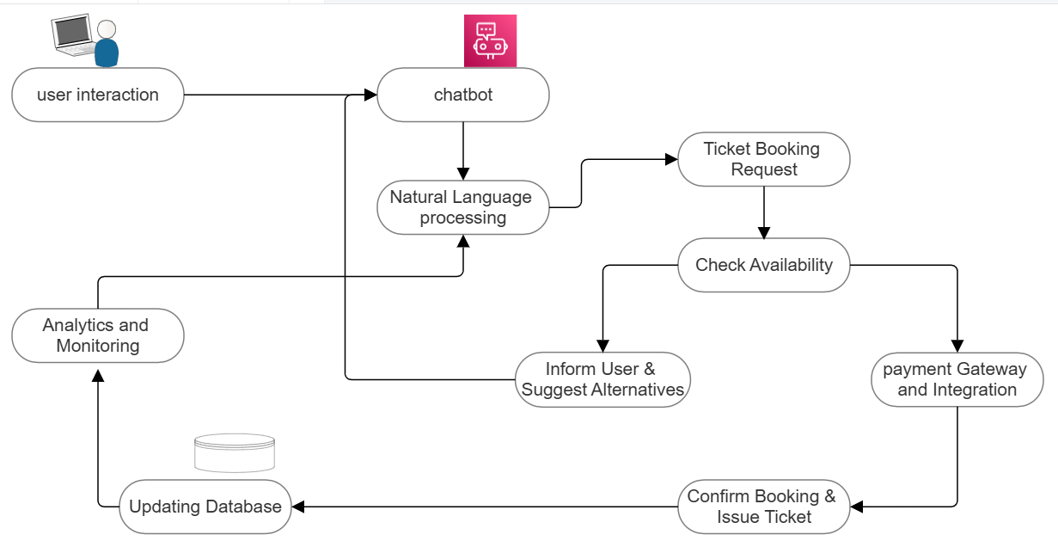
Architecture Diagram

Slide 8
Modules
User Interface Module – Chatbot-based interaction for ticket booking.
Authentication Module – Secure user login and verification.
Booking Management Module – Handles seat selection, availability checks, and ticket issuance.
Payment Gateway Module – Secure payment processing via multiple methods.
Multilingual Support Module – Enables users to interact in different languages.
Admin Panel Module – Allows administrators to manage bookings, cancellations, and reports.

Slide 9
Hardware and Software Details
Hardware Requirements:
Cloud-based server for chatbot hosting.
Secure database storage.
High-speed internet connectivity.
Software Requirements:
Python/Node.js for chatbot development.
Natural Language Processing (NLP) frameworks (e.g., Dialogflow, Rasa, or IBM Watson).
MySQL/PostgreSQL for database management.
Secure Payment APIs (e.g., PayPal, Stripe, Razorpay).
Frontend framework (React.js/Vue.js) for web interface.
Cloud deployment (AWS, Google Cloud, or Azure).

Slide 10
Timeline of the Project (Gantt Chart)

Slide 11
References (IEEE Paper format)
IEEE Xplore: "Ticketing Chatbot Service using Serverless NLP Technology" https://ieeexplore.ieee.org/document/8576921
ResearchGate: "Chatbot Based Ticket Booking System for All Modes of Transport" https://www.researchgate.net/publication/384752841_Chatbot_Based_Ticket_Booking_System_for_All_Modes_of_Transport
IEEE Xplore: "A Survey on Chatbot Implementation in Customer Service Industry through Deep Neural Networks" https://ieeexplore.ieee.org/document/8592630
ResearchGate: "Application of Chatbots and Virtual Assistants in Ticket Booking System" https://www.researchgate.net/publication/381036706_Application_of_Chatbots_and_Virtual_Assistants_in_Ticket_Booking_System
IEEE Xplore: "A Conversation-Driven Approach for Chatbot Management" https://ieeexplore.ieee.org/document/9681834
ResearchGate: "Chat-Bot Based Ticketing System Using Dialogflow and Llama LLM" https://www.researchgate.net/publication/385421936_Chat-Bot_Based_Ticketing_System_Using_Dialogflow_and_Llama_LLM

Slide 12
References
IEEE Xplore: "Virtual Assistant for Appointment Booking" https://ieeexplore.ieee.org/document/10126199
ResearchGate: "ChatBot-based Bus Ticket Booking Prototype Using WhatsApp" https://www.researchgate.net/publication/382953388_ChatBot-based_Bus_Ticket_Booking_Prototype_Using_WhatsApp
IEEE Xplore: "Building an Arabic Flight Booking Dialogue System Using a Hybrid Approach" https://ieeexplore.ieee.org/document/9316174
ResearchGate: "A Chatbot-Based Strategy for Regional Language-Based Train Ticket Ordering Using a Novel ANN Model" https://www.researchgate.net/publication/373417828_A_Chatbot-Based_Strategy_for_Regional_Language-Based_Train_Ticket_Ordering_Using_a_novel_ANN_Model

Slide 13


